Slide 1
Workshop on Reducing Internet Latency goals for taxonomy session
survey sources of latency
categorise solutions
quantify benefits
consider deployment aspects
short-term & long-term applicability
common reference framework for discussions
schedule
[10-15] Joe Touch, ISI Factors underlying the problem space
[10-15] Bob Briscoe, BT Solution space – systems focus
[10-15] Lucien Avramov, Cisco Solution space – intra-box focus
[10-15] open to contributions from the floor
[50-30] discussion

Slide 2
survey of latency reducing techniques and their merits a work in progress
Bob Briscoe, Anna Brunstrom, Gorry Fairhurst, Stein Gjessing, David Hayes, Andreas Petlund, David Ros, Ing-Jyh Tsang

Slide 3
goal for this talk
industry roadmap of techniques
gain vs pain
latency reduction against deployability
“A Survey of Latency Reducing Techniques and their Merits”
~190 references
a work in progress
available soon via http://riteproject.eu/publications/
evolved from BT roadmap work, but repurposed
a company tries to prioritise the quick wins
an industry also needs to identify hard problems being avoided

Slide 4
latency-reducing techniques organised by sources of delay
3.1 Structural delays
3.1.1 Server placement
3.1.2 Sub-optimal route latency
3.1.3 Name resolution
3.1.4 Content placement
3.2 Interaction between endpoints
3.2.1 Protocol Initialisation
3.2.2 Secure session initialisation
3.2.3 Packet loss recovery delays:
3.3 Reducing delays along transmission paths
3.3.1 Propagation delay
3.3.2 Switching/routing delay
3.3.3 Queueing delay
3.3.4 Error correction delays
3.4 Reducing delays related to link capacities
3.4.1 Insufficient capacity
3.4.2 Redundant information
3.4.3 Under-utilised capacity
3.4.4 Collateral damage
3.4.4 Medium acquisition delays
3.5 Intra-end-host delays
3.5.1 Transport Protocol Stack buffering
3.5.2 Operating system delay

Slide 5
latency-reducing techniques organised by sources of delay
3.1 Structural delays
3.1.1 Server placement
3.1.2 Sub-optimal route latency
3.1.3 Name resolution
3.1.3.1 DNS cache placement
3.1.3.2 DNS cache pre-fetching
3.1.4 Content placement
3.1.4.1 Proxies and caches
3.1.4.2 Prediction and latency hiding
3.2 Interaction between endpoints
3.2.1 Protocol Initialisation
3.2.1.1 TCP fast open
3.2.1.2 Pipelining
3.2.2 Secure session initialisation
3.2.2.1 Transport layer security negotiation
3.2.2.2 Building encryption into TCP
3.2.2.3 Bootstrapping security from the DNS
3.2.3 Packet loss recovery delays:
3.2.3.1 Application tolerance to errors and order of delivery
3.2.3.2 Reduce error detection time
3.2.3.3 Add redundancy
3.3 Reducing delays along transmission paths
3.3.1 Propagation delay
3.3.1.1 Straighter cable paths
3.3.1.2 Higher signal velocity
3.3.1.3 Combining higher signal velocity and straighter routes
3.3.2 Switching/routing delay
3.3.3 Queueing delay
3.3.3.1 Flow and circuit provisioning
3.3.3.2 Packet scheduling
3.3.3.3 Traffic shaping and policing
3.3.3.4 Small buffers
3.3.3.5 Queue management
3.3.3.6 Transport-based queue control
3.3.4 Error correction delays
3.3.4.1 Improve channel quality
3.3.4.2 Hop based error correction and packet ordering
3.4 Reducing delays related to link capacities
3.4.1 Insufficient capacity
3.4.2 Redundant information
3.4.3 Under-utilised capacity
3.4.3.1 More aggressive congestion control
3.4.3.3 Rapidly sensing available capacity
3.4.4 Collateral damage
3.4.4 Medium acquisition delays
3.5 Intra-end-host delays
3.5.1 Transport Protocol Stack buffering
3.5.2 Operating system delay

Slide 6
case (1a): small (20kB) flow over WAN
reduction in completion time
100%
DCTCP
data pre-fetch
CDN
AQM
ECN
tcpcrypt
TLS-FS+ TFO+IW10
50%
micro- wave
TFO+IW10
hollow fibre
TLS-FS
TFO
IW10
straighten routes
DNS pre-fetch
RTO-restart
0
Very Hard or Costly
Feasible
Deploy- ability
for example...
all at once
both ends & network
both ends
sender only
network only

Slide 7
case (1b): small (20kB) flow over LAN
reduction in completion time
100%
data pre-fetch
DCTCP
TLS-FS+ TFO+IW10
tcpcrypt
ECN
cache
AQM
50%
TFO+IW10
TLS-FS
TFO
IW10
DNS pre-fetch
hollow fibre
straighten routes
proxy
RTO-restart
0
Very Hard or Costly
Feasible
Deploy- ability
for example...
all at once
both ends & network
both ends
sender only
network only

Slide 8
case (2a): large flow over WAN
reduction in completion time
100%
data pre-fetch
50%
CDN
hollow fibre
TLS-FS
0
DCTCP
microwave
ECN
AQM
TFO+IW10
DNS pre-fetch
Very Hard or Costly
Feasible
Deploy- ability
for example...
all at once
both ends & network
both ends
sender only
network only

Slide 9
Transaction Layer Security (TLS) aka secure sockets layer (SSL) or https
client
server
SYN
RTT
SYN-ACK
TLS adds: 2 RTTs
False Start cuts this to: 1 RTT
TLS with TCP handshake: 3 RTTs
TLS with TCP Fast Open: 1 RTT
RTT
ACK
CL-Hello
RTT
SV-Hello
SSL-Config
SSL-Config
Finished
RTT
Finished
data request
data response
time

Slide 10
a figure of merit: average rate
Bob Briscoe, BT
Anna Brunstrom, Mohammad Rajiullah, Karlstad University
Olga Bondarenko, Simula Research Labs

Slide 11
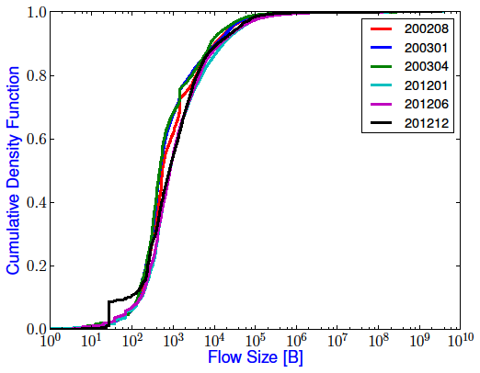
inaccessible capacity in a dedicated access link
capacity inaccessible to a lone flow in a:
1Gb/s link
80Mb/s link
IW: initial window (Google has just increased from 3 to 10)
R: round trip time (~20ms: intra-UK ~200ms inter-continent)
X: bottleneck capacity
below a certain size, a single transfer (of any number of flows) is limited by the slow-start rule, not capacity
as capacity growth continues, more transfers are limited by the rule than by capacity

Slide 12
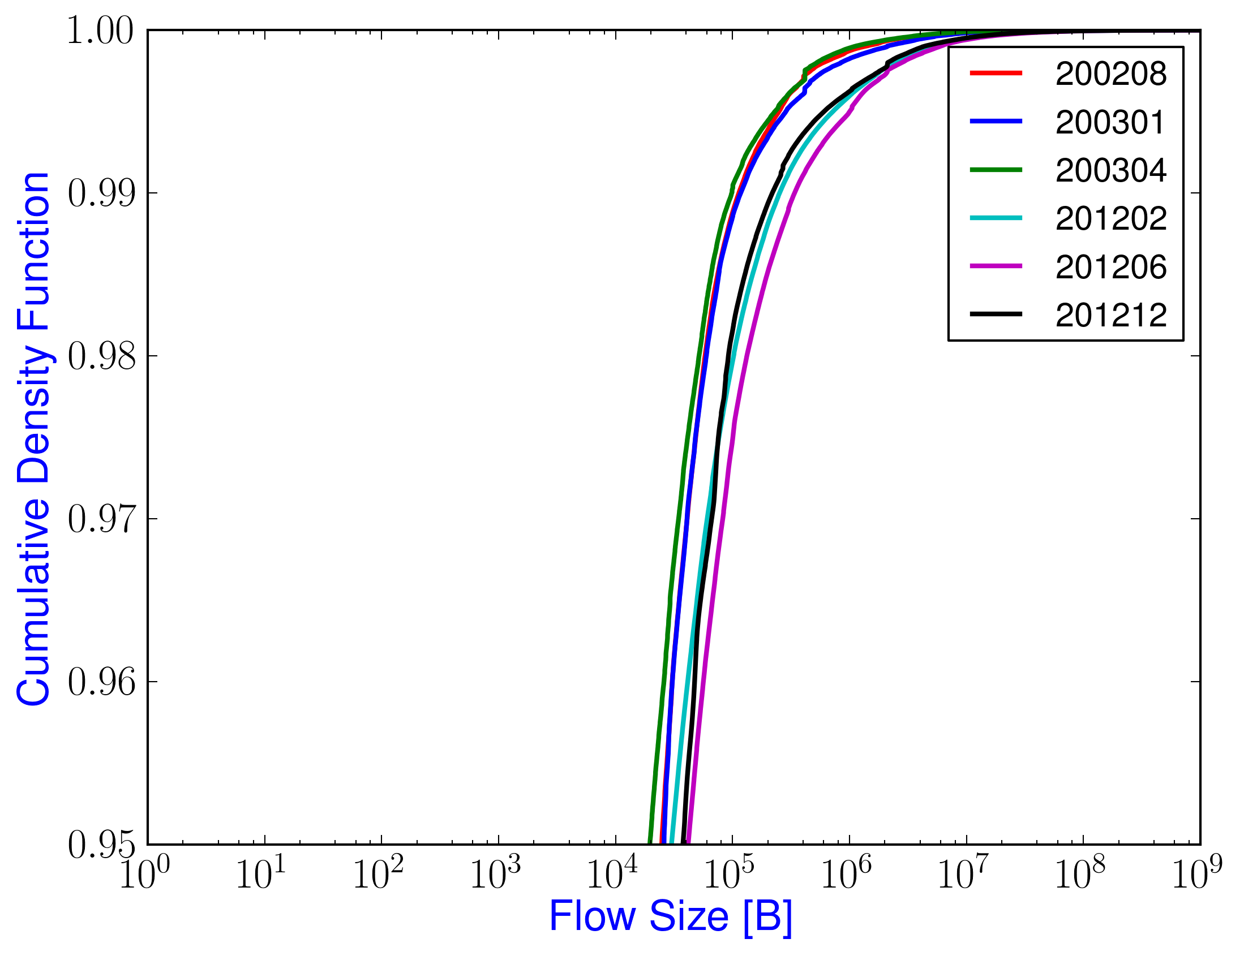
CDF w.r.t # of Flows
Fig. 1: Prob. of number of flows seen for a given flow size

Slide 13
CDF w.r.t Fraction of Bytes
Fig. 2: Prob. of fraction of total bytes transferred for a given flow size

