Slide 1



Immediate ECN
Mirja Kuhlewind, David Wagner,
Juan Manuel Reyes Espinosa, Stuttgart Uni
Bob Briscoe, BT
IETF-88 TSVAREA
Nov 2013
Bob Briscoe was part-funded by the European Community
under its Seventh Framework Programme through the
Reducing Internet Transport Latency (RITE) project ICT-317700

Slide 2
summary & context
Promising early results towards the aim of:
  the predictably low queuing delay of DCTCP*
  deployable on the public Internet, with existing hardware
  zero config or config-insensitive
At IAB rmcat workshop, we foresaw a need to address:
Why bring such early results to the IETF?
  to test the water on a redefinition of ECN
    to foster ECN deployment through more significant benefits
problem | IETF wg formed | this proposal
real-time media congestion avoidance | rmcat | -
prevent TCP bloating queues | aqm | ✓
make TCP smoother | - | ✓
* DCTCP: data centre TCP

Slide 3
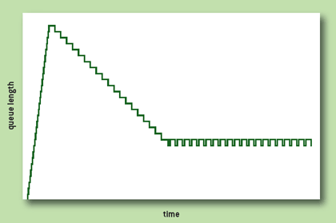
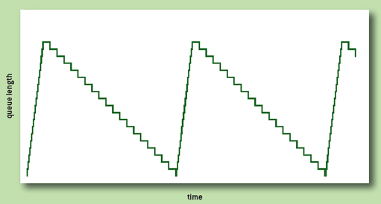
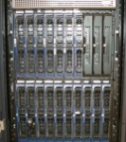


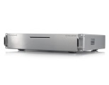
problem
AQM dynamics
good(?)
queue
good(?) queue
bad
queue
buffer’s job: absorb bursts that dissipate by themselves
all AQMs defer dropping for c.1 worst-case RTT
for a flow with RTT of 20ms or 4ms
    e.g. content distribution network or home media server
    these AQMs suppress any signal for 5 or 25 of the flow’s own RTTs
CoDel, PIE: auto-tune for varying line-rate
also need to auto-tune for varying RTT
it’s not ‘good’ to hold back from signalling for 100ms
it’s just necessary if the alternative is drop
100ms
origin
RED | w_q | 512 pkt*
PIE | max_burst | 100ms
CoDel | interval | 100ms
20ms
CDN
4ms
home
media
server
* @10Mb/s & 700B/pkt, 512pkt → 3s for moving ave of queue to reach 63% of inst queue,
but not comparable with PIE & CoDel delays, which are absolute

Slide 4


AQM dynamics solution
[from DCTCP]
smoothing
congestion signals
For ECN-capable packets
  shift the job of smoothing congestion signals from network to host
    the network signals ECN with no smoothing delay
    the transport can hide bursts of ECN signals from itself
the transport knows
    whether it's TCP or RTP etc
    whether its in cong avoidance or slow-start
    and it knows its own RTT
then short RTT flows can smooth the signals themselves
delayed only by their own RTT
    so they can fill troughs and absorb peaks that longer RTT flows cannot
so it can decide
    whether to respond immediately
    or to smooth the signals
    and, if so, over what time

Slide 5
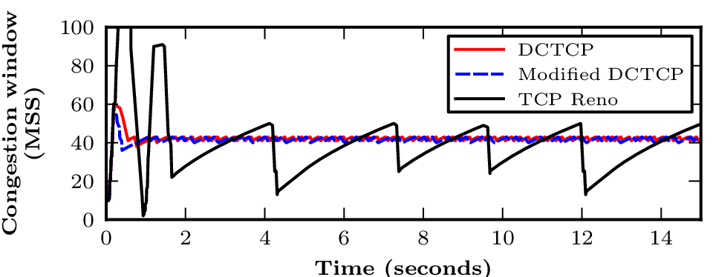
aims: real performance gain
(and avoid RTT-sensitive config)
DCTCP on host uses immediate ECN
DCTCP only smooths the ECN signals while in congestion avoidance
DCTCP in slow-start responds without smoothing, immediately reducing overshoot
* Modified DCTCP is only shown separate from DCTCP, because we improved the original DCTCP slightly

Slide 6
Data Centre TCP (DCTCP) high utilisation in steady state still leaves room for bursts highly insensitive to configuration
buffer kept for bursts
buffer
occupancy
b u f f e r s i z e
TCP saw-teeth seeking
the operating point
DCTCP:
more
smaller
saw-teeth
queue
management
operating point
shallower
operating
point
lower queuing delay
line
utilisation
good line utilisation
cuts delay but poorer line utilisation
time
Today (at best)
TCP on end-systems
RED in queues
if solely change queues
change queues
and end-systems

Slide 7
aim: real performance gain
classic ECN
    cannot justify deployment pain
    for a questionable performance gain
immediate ECN
    addresses predictability and low queuing delay
    including self-delay for short flows
    avoiding RTT-sensitive config

Slide 8
problem II co-existence of DCTCP with existing Internet traffic
data centre TCP was so-called only because it couldn’t co-exist with Internet traffic
can’t have a low delay threshold for ECN
and a deep threshold for drop
in one FIFO queue
drop traffic would
push the queue to its
own balance point
causing 100% marking
of ECN packets
then ECN traffic would starve itself
1
✗
ECN
drop
packet mark/drop
probability
0
Queue

Slide 9
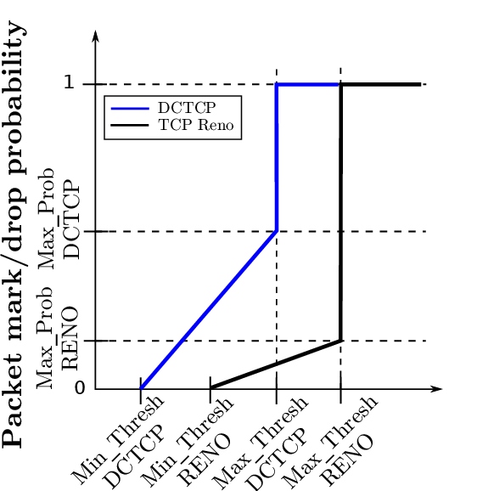
co-existence solution can use existing network hardware
use weighted RED (WRED) implementation
in an unusual configuration
  one FIFO queue with two instances of RED algo
    smoothed queue for drop (EWMA-constant = 9 say)*
    current queue for ECN (EWMA-constant = 0)
as share of DCTCP grows
  more insensitive to config
ECN
drop
* if exponential-weighting-constant = B,
then RED smooths the queue over 2^{B} packets
if B = 9, RED smooths over 2⁹ = 512 packets
if B = 0, RED smooths over 2⁰ = 1 packet (i.e. it doesn’t smooth)
Instantaneous
or Averaged
Queue
q(w_{q})

Slide 10
a similar coexistence approach should be applicable to other AQMs
ultimately, want to auto-tune against line-rate and RTT
  use a modern AQM that uses queuing delay as its metric
  and separate drop and ECN algos
message for implementers in silicon
    ensure parameters can be configured separately for ECN
AQM | smoothing parameter | non-ECN packets | ECN packets
ARED | ewma-const | 9 | 0
PIE | max_burst | 100ms | 0
CoDel | interval | 100ms | 0

Slide 11
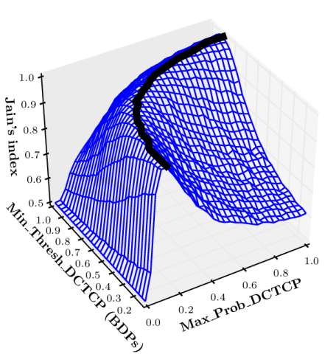
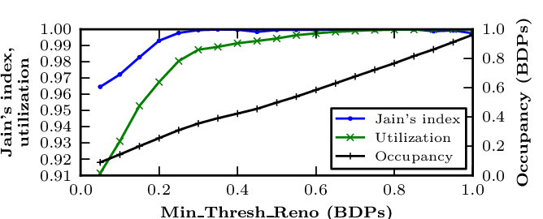
co-existence results of ‘gating tests’
explored large part of the much larger parameter space
    implemented in Linux 3.2.18; simulated in IKR simlib
    ‘gating tests’: long-running flows only
    paper under submission, available on request
robust against starvation
formula to derive
ECN config from drop config
to maintain rate fairness
can then find sweet spot
for the drop config
ECN
drop
Averaged
Queue
q(w_{q})

Slide 12
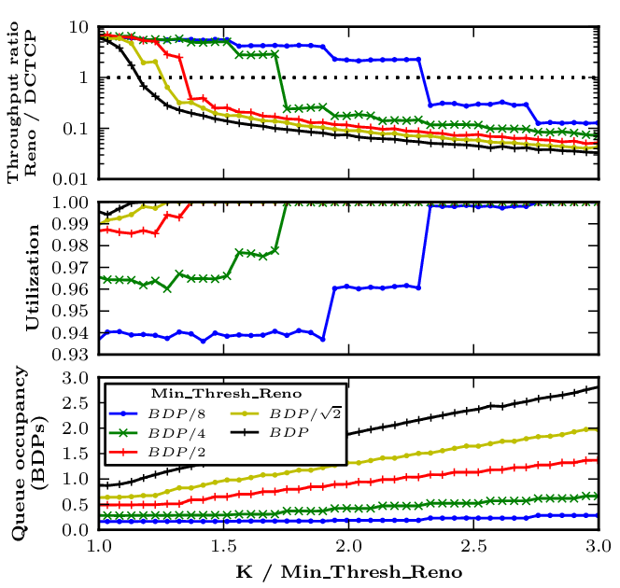
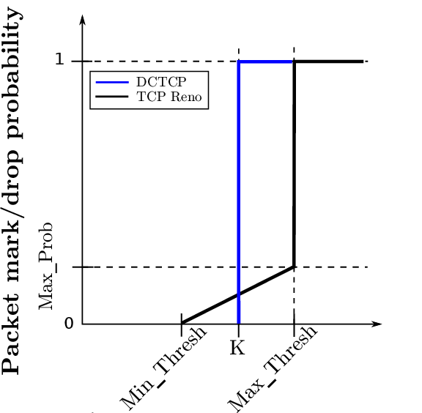
a sample of the results so far
ECN
drop
Instantaneous queue
Averaged queue
(w_{q})
early deployment, when traffic mostly drop-based
have to set drop (and therefore ECN) threshold deep
as more flows shift to DCTCP,
can set both thresholds shallower

Slide 13
problem III incremental deployment interop between classic and immediate ECN
ECN widely implemented on hosts:
  on by default at TCP servers
  off by default at TCP clients
turn clients on by default when deploy:
  accurate ECN feedback & ECN fall-back
host buffers | small smoothed responses to each ECN | one big instant response to ECN per RTT
immediate ECN | ✓ | ✓¹
smoothed ECN | ✓² | ✓
smoothing
congestion signals
¹ don’t get full gain in latency until host upgrades as well
² doubly delayed response to congestion
these two ticks are based on conjecture, not experimental evidence (yet)

Slide 14
cross-layer / cross-wg impact on IETF
 | component | IETF wg | document
1 | redefine meaning of ECN CE | tsvwg | Expt update to RFC3168
2 | specify ECN behaviour in AQM algos | aqm | CoDel, PIE, (RED++?)
3 | specify change to TCP feedback | tcpm | draft-ietf-accurate-ecn-reqs
4 | specify change to TCP sender algo | tcpm | Expt update to RFC5861
RFC 3168 may not need to be updated (see spare slide)
urgent given pace of AQM development
wire protocol: the main standards track change
algorithm experimentation expected

Slide 15
concluding messages
research in progress
promise of predictably low delay during dynamics
    an unnecessary queue is not a ‘good’ queue
adds RTT auto-tuning to AQM
    by shifting smoothing from network to host
can use existing network hardware
if you’re implementing a new AQM
    at least ensure parameters can be configured separately for ECN
question: if subsequent experiments are as promising as these,
would there be an appetite in the transport area
to tweak the meaning of ECN?

Slide 16
Immediate ECN
Q&A
spare slides

Slide 17
which codepoint for immediate ECN?
To use CE for immediate ECN,
may not need to update RFC3168 (Addition of ECN to IP):
  ...if the ECT codepoint is set in that packet's IP header ... then instead of dropping the packet, the router MAY instead set the CE codepoint in the IP header.
  An environment where all end nodes were ECN-Capable could allow new criteria to be developed for setting the CE codepoint, and new congestion control mechanisms for end-node reaction to CE packets. However, this is a research issue, and as such is not addressed in this document.
  Could use ECT(1) for immediate ECN
    but this unnecessarily wastes the CE codepoint
    (who would want ‘sluggish ECN’?)

Slide 18
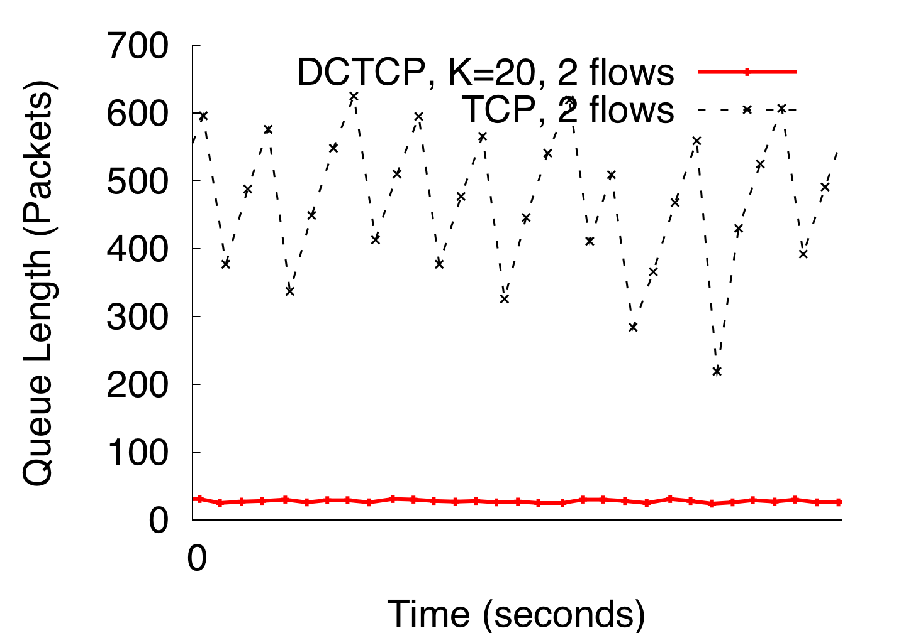
DCTCP in Action
(Kbytes)
Setup: Win 7, Broadcom 1Gbps Switch
Scenario: 2 long-lived flows, K = 30KB
20
Notes:
Not ns2.
K = 30KB => 20 packets
18

Slide 19
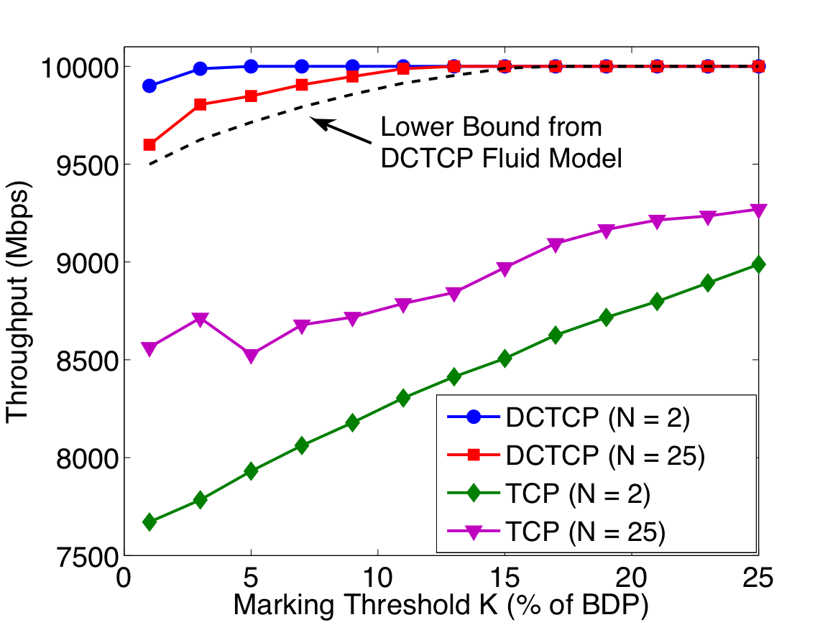
Throughput-Latency Tradeoff
Throughput > 94% as K → 0
For TCP:
Throughput → 75%
Parameters:
link capacity = 10Gbps
RTT = 480μs
smoothing constant (at source), g = 0.05.
18
Notes:
Bandwidth-delay product = 400 x 1500B packets

Slide 20
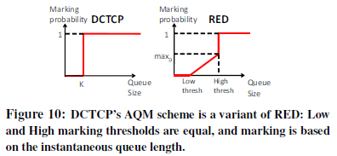
DCTCP activity
Averaged
Figures courtesy of Alizadeh et al
E2e Transport
  In Windows 8 Server
  data center template
  I-D for DCTCP feedback (intended EXP)
  [draft-kuehlewind-tcpm-accurate-ecn-01]
AQM
  Existing kit: Just a degenerate config of RED
  Can be implemented as just a step at K packets (single ‘if’ command)
  For zero-delay can use a virtual queue [RC5670]
    hardware implementations [“How to Build a Virtual Queue from Two Leaky Buckets”]
    see HULL for specifics with DCTCP
Analysis, papers, Linux & ns2 implementation, etc
  <http://www.stanford.edu/~alizade/Site/DCTCP.html>
  SIGCOMM paper gives entry point

Slide 21
Data Center TCP Algorithm
Switch side:
Mark packets when Queue Length > K
B
K
Don’t
Mark
Mark
  Sender side:
  Maintain moving average of fraction of marked packets (α)
  Adaptive congestion window decrease:
Notes:
very simple marking mechanism
not all the tunings other aqms have
on the source side, the source is tryign to estimate the fraction of packets getting marked
using the obs that there is a stream of ecn marks coming back – more info in the stream than in any single bit
trying to maintain smooth rate variations to operate well even when using shallow buffers, and only a few flows (no stat mux)
F over the last RTT. In TCP there is always a way to get the next RTT from the window size. Comes from the self-clocking of TCP.
Only changing the decrease. Simplest version – makes a lot of sense. So generic could apply it to any algorithm – CTCP, CUBIC – how to cut its window leaving increase part to what it already does. Have to be careful here.
21

