Slide 1
Reducing Internet Latency: a survey of techniques and their merits
Bob Briscoe, Anna Brunstrom, Andreas Petlund, David Hayes, David Ros, Ing-Jyh Tsang, Stein Gjessing, Gorry Fairhurst, Carsten Griwodz, Michael Welzl

Slide 2
summary
industry roadmap of techniques
gain vs pain
latency reduction against deployability
“A Survey of Latency Reducing Techniques and their Merits”
322 references
available via http://riteproject.eu/publications/
evolved from BT roadmap work, but repurposed
a company tries to prioritise the quick wins
an industry also needs to identify hard problems being avoided

Slide 3
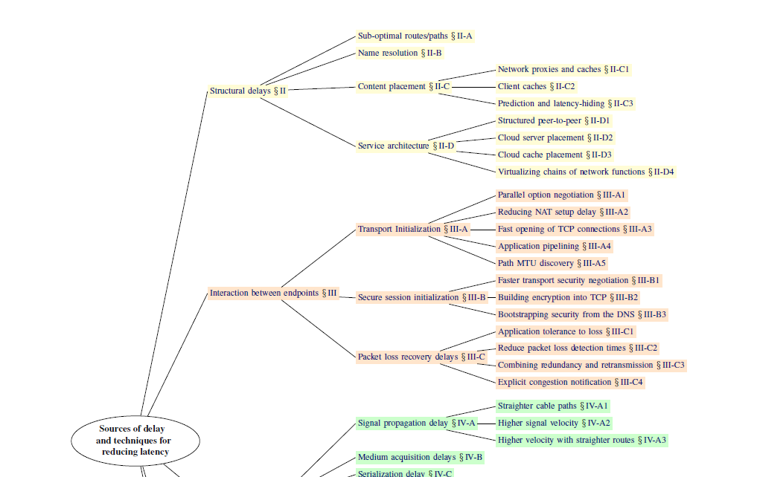
roadmap around body of survey I

Slide 4
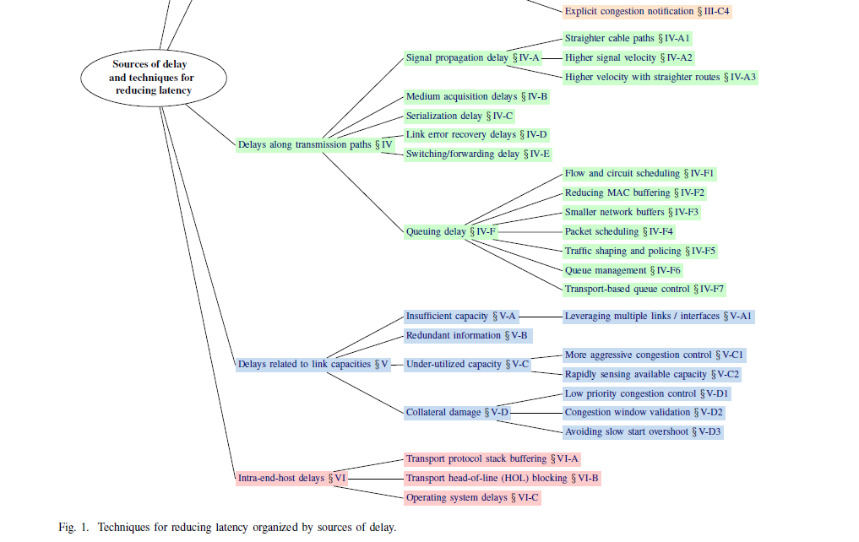
roadmap around body of survey II

Slide 5
case (1a): small (20kB) flow over WAN
reduction in completion time
100%
DCTCP
data pre-fetch
FEC/TCP
TLP
ECN+AQM
DNS pre- fetch
AQM
CDN
50%
QS
micro- wave
hollow fibre
TLS-FS
TFO
IW10
straighter links
RTO-restart
no DSL interleave
0
Deploy- ability
Very Hard or Costly
Straightforward
for example...
all at once
both ends & network
both ends
sender only
network only

Slide 6
case (1b): small (20kB) flow over LAN
reduction in completion time
100%
data pre-fetch
DCTCP
ECN+AQM
AQM
50%
QS
TLS-FS
TFO
IW10
DNS pre- fetch
hollow fibre
straighter links
0
RTO-restart
Deploy- ability
Very Hard or Costly
CDN
Straightforward
for example...
all at once
both ends & network
both ends
sender only
network only

Slide 7
case (2a): large flow over WAN
reduction in completion time
100%
data pre-fetch
50%
CDN
0
hollow fibre
QS
TLS-FS
TFO
IW10
Deploy- ability
DCTCP
microwave
ECN
no DSL interleave
AQM
DNS pre-fetch
Very Hard or Costly
Straightforward
for example...
all at once
both ends & network
both ends
sender only
network only

Slide 8
case (2b): large flow over LAN
reduction in completion time
100%
data pre-fetch
50%
0
hollow fibre
QS
TLS-FS
TFO
IW10
Deploy- ability
DCTCP
CDN
ECN
AQM
DNS pre-fetch
Very Hard or Costly
Straightforward
for example...
all at once
both ends & network
both ends
sender only
network only

