Slide 1
Inner Space for tcpinc
Bob Briscoe
Nov 2014
draft-briscoe-tcpm-inner-space-01
Bob Briscoe's work is part-funded by the European Community under its Seventh Framework Programme through the Trilogy 2 (ICT-317756) and the RITE (ICT-317700) projects

Slide 2
opportunistic encryption
Reminder: Project Goal
IPsec
SSL
TLS
tcpinc depends on TCP options
TCP options are changing...
special session in tcpm on 4 drafts
No handshake latency
Middlebox not a downgrade
How? Inner Space protocol
Authentication coverage insights
unencrypted
TCP traffic today
unencrypted
IPsec
SSL
TLS
opportunistic
Goal for TCP traffic

Slide 3
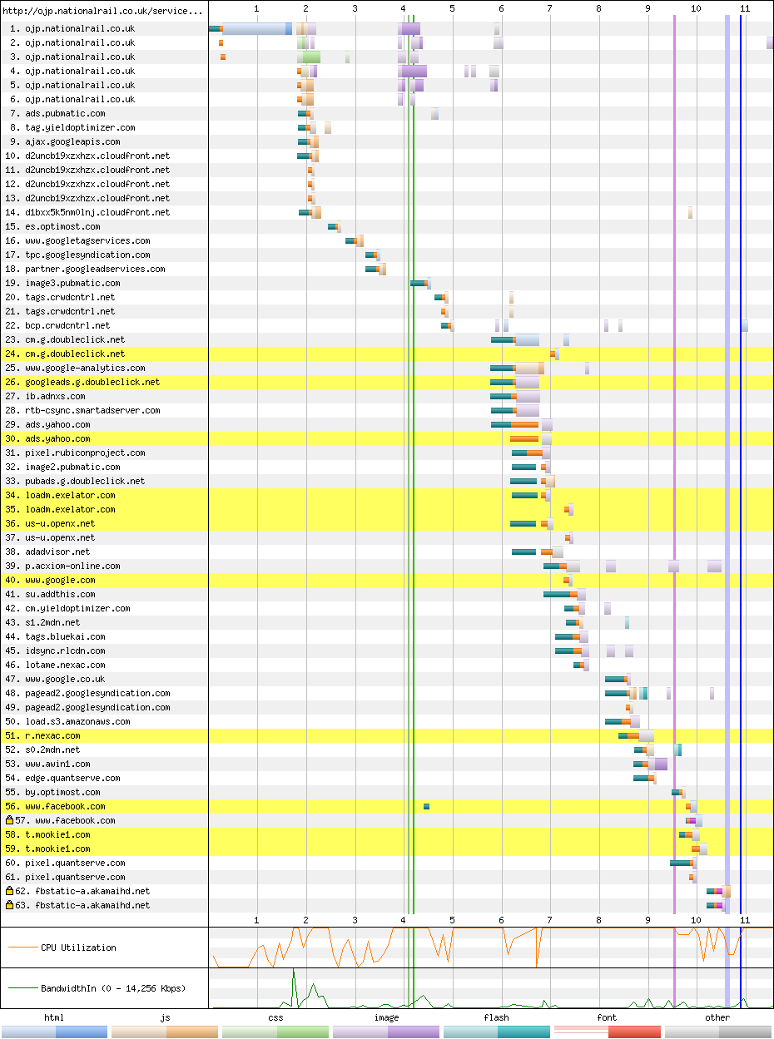
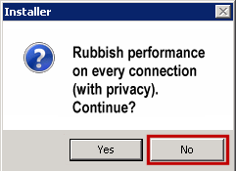
opportunistic delay
Reminder: Project Goal
IPsec
SSL
TLS
unencrypted
TCP traffic today
unencrypted
IPsec
IPsec
SSL
SSL
Ave. Alexa 1000 Web page
44 TCP connections*
from 15 servers†
TLS
TLS
* as of Nov 2014
† as of early 2013
httparchive.org
unencrypted
opportunistic
Goal for TCP traffic
Result
opportunistic

Slide 4
tcpcrypt latency & Inner Space session initialisation
without
with Inner Space
client data first
server data first
SYN
SYN
tcpcrypt.v2 0.5 RTT
Hello
tcpcrypt.v2 1 RTT
INIT1+
Legend: loop groups messages that can be sent in the same packet
SYN-ACK
SYN-ACK
tcpcrypt 2 RTT
PKCONF
INIT2+
ACK
MAC
INIT1
(App data)
ACK
ACK
INIT2
MAC
TCP header
TCP options
App data
App data
App data
`
cleartext ciphertext
time
INIT1, sym-cipher-list, N_C, pub-cipher, PK_C
INIT2, sym-cipher, KX_S
INIT1+, pub-cipher-list, sym-cipher-list, N_C, PK_C
INIT2+, sym-cipher, KX_S; MAC<m>
cuts out two states
decouples tcpcrypt from TCP state machine?

Slide 5
tcpcrypt latency with Inner Space session resume
without
with Inner Space
client data first
SYN
tcpcrypt.v2 0 RTT
SYN
tcpcrypt 1 RTT
(TFO)
MAC
Legend: loop groups messages that can be sent in the same packet
NEXTK1
TFO
SYN-ACK
NEXTK1
NEXTK2
App data
ACK
SYN-ACK
MAC
MAC
App data
NEXTK2
TCP header
TCP options
App data
App data
MAC
NEXTK2
App data
`
cleartext ciphertext
time
see [Briscoe14] for details

Slide 6
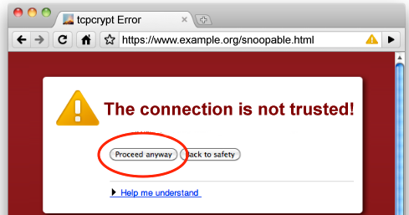
middleboxes: detect-and-downgrade? not good enough
unknown TCP option stripped
to port | % paths
80 (HTTP) | 14%
443 (HTTPS) | 6%
34343 (unassigned) | 4%
[Honda11]
tcpinc (tcpcrypt and TCP-TLS) relies on new TCP options
so tcpinc would disable itself on ~10% of paths
when middlebox downgrade of tcpinc is so unremarkable it makes a downgrade attack indistinguishable from a middlebox
<large_agency> can snoop on anyone

Slide 7
middlebox domination strategy
long term aim
authenticate options
if turned on option authentication today
~10% of connections would break
the ends break a working service
middlebox domination strategy
Inner Space + option authentication (breaks 0%)
then, if middleboxes move into the TCP data
the middleboxes break a working service
if you want to shoot them,
why shoot yourself in the foot
when you can make them shoot themselves in the foot?

Slide 8
Inner Space – TCP segment structure (SYN=0)
Before
IP Payload Size
Data Offset (DO)
Base TCP header
Outer Options
TCP Payload
After (SYN=0)
Inner Options Offset (InOO)
Sent Payload Size (SPS)
Len=1
Base TCP header
Outer Options
InSpace Option
Inner Options
TCP Payload
Not to scale
All offsets in 4-octet word units, except SPS is in octets
Sent payload size (SPS) | Inner Options Offset (InOO) | Len
16b | 14b | 2b
InSpace is solely a framing header

Slide 9
Inner Space – TCP segment structure
SYN=1
Inner Options Offset (InOO)
Sent Payload Size (SPS)
1
Len=2
Base TCP header
Outer Options
Magic A
InSpace Option
Inner Options
TCP Payload
SYN=0
Inner Options Offset (InOO)
Sent Payload Size (SPS)
Len=1
Base TCP header
Outer Options
InSpace Option
Inner Options
TCP Payload
TCP Data
presence of Inspace flagged by magic no. at start of each stream
avoided an Outer TCP Option as the flag, which could be stripped
inherently safe to flag within the payload – shares fate with options

Slide 10
Inner Space – TCP byte-stream
Sent
Magic No. A
InSpace Option
Inner Options
InSpace Option
Inner Options
InSpace Option
Inner Options
Control
Data
TCP Payload
TCP Payload
TCP Payload
Received
Magic No. A
InSpace Option
Inner Options
InSpace Option
Inner Options
InSpace Option
Inner Options
TCP Payload
TCP Payload
TCP Payload
robust to resegmentation
Inner Options not prone to stripping
reliable ordered delivery of Inner Options
makes rekey easy (gives tcpcrypt TLS-like records)
tcpinc can encrypt Inner Options (incl. its own)

Slide 11
rekey message on an unreliable unordered segment
Inner Options: reliable, ordered
rekey
InSpace
A
InSpace
B
InSpace
C
InSpace
D
InSpace
E
control
data
(common) case of no data in one direction for a while
TCP Payload
TCP Payload
Outer Options: not
C
rekey
TCP-AO added bespoke solution: lists operative keys in every header then switches key back and forth during out of order headers
B
A
E
control
data
TCP Payload
TCP Payload
drop
problematic if key applies to headers
D

Slide 12
transformation of the datastream controlled by TCP options within the datastream
e.g. (de)crypt, (de)compress
care with processing order: recursion limited to one level
SYN=1:
if not previously found MagicA, retry after transformation
SYN=0:
(de)crypt progressively
up to the end of each set of Inner Options
process those options
then continue with next segment (might be with a new key)

Slide 13
transformation of the datastream controlled by TCP options within the datastream
e.g. (de)crypt, (de)compress
care with processing order: recursion limited to one level
SYN=1:
if not previously found MagicA, retry after transformation
SYN=0:
(de)crypt progressively
up to the end of each set of Inner Options
process those options
then continue with next segment (might be with a new key)

Slide 14
message authentication coverage
InSpace Option
Inner Options
MAC
TCP Payload
TCP Payload
coverage options [Marcelo BB]:
payload only
payload plus some header fields
MAC in a TCP option
MAC in the payload
possible exception: MAC for pure ACKs in TCP option
MAC for header in a TCP option; and for payload in payload
MAC in a TCP option... in the payload
Inner Space preserves the 1-1 mapping between
MAC, payload & Inner TCP options of each segment
but not Outer Options and not the main TCP header (next slide)
gotcha: MAC consumes sequence space on pure ACK
could write ad hoc rules, e.g. "defer ACK if no payload"
full solution (next revision): unreliable & reliable Inner Options

Slide 15
message authentication of the main TCP header
middlebox transformations
NAT
resegmentation
Seq No Shift
ACK thinning
<more will be discovered>
not really attacks, but naive authentication would fail
approach so far: absolve these headers from authentication
a feasible approach (not universally applicable)
using inner options, sender reveals the original* once per connection
rcvr reverses shifts, reconstructs sent (pseudo)segments
rcvr verifies sent MAC against reconstructed pseudosegments
summary: verify that header transformations are consistent
* privacy concern?

Slide 16
Inner Space – encapsulation model
App
Middle-box
App
TCP Payload
TCP
Inner Options Within TCP Data
TCP
Middle-box
TCP Header & Outer Options
IP
IP
IP
IP

Slide 17
Inner Space – applicability & compatibility^{1,2}
re: connection
Max Segt Size
SACK-ok
Wnd Scale
Timestamp (1st)
TCP-AO
TCP Fast Open
MPTCP (excl. DACK)
tcpcrypt MAC
TCP-TLS
re: connection
Max Segt Size
SACK-ok
Wnd Scale
Timestamp (1st)
TCP-AO
TCP Fast Open
MPTCP (excl. DACK)
tcpcrypt MAC
TCP-TLS
re: stream delivery
tcpcrypt CRYPT
App
Middle-box
App
TCP Payload
TCP
Inner Options Within TCP Data
TCP
Middle-box
TCP Header & Outer Options
IP
IP
IP
IP
re: segment delivery
Timestamps
SACK
MPTCP Data ACK
MAC (if covers header)
¹ Many of the above schemes involve multiple different types of TCP option, see draft.
² Next revision supports all options as Inner

Slide 18
summary
TCP
TCP
much more TCP option space
cuts handshake latency ...as a service
middlebox traversal ...as a service
sent segment reconstruction ...as a service
reliable ordered options ...as a service
next steps
mismatch in maturity?
tcpm chairs: "no hurry"
tcpcrypt.v2 decomposition
review pls
path testing
data in SYN, is DPI bypass necessary? viable?
implementation
compatibility testing
IAB workshop on stack evolution in a middlebox Internet
principles

Slide 19
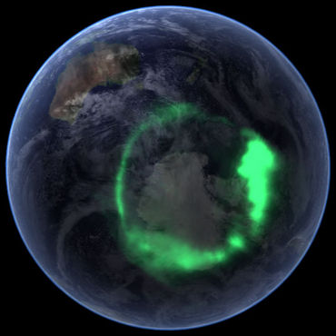

Slide 20
contents
No handshake latency
Middlebox not a downgrade
How? Inner Space protocol
Authentication coverage insights
Spare slides
More info
Dual handshake
Overhead
Extensions – DPI traversal, EchoCookie
Tricky bits
Interaction with TCP Fast Open
Work in progress

Slide 21
more info
Inner Space for TCP Options
draft-briscoe-tcpm-inner-space
[Bagnulo14] Protect or not the TCP header fields
http://www.ietf.org/mail-archive/web/tcpinc/current/msg00359.html
[Briscoe14] tcpcrypt decomposition:
http://www.ietf.org/mail-archive/web/tcpinc/current/msg00384.html
[Honda11]
Honda, M., Nishida, Y., Raiciu, C., Greenhalgh, A., Handley, M., and H. Tokuda, "Is it Still Possible to Extend TCP?", Proc. ACM Internet Measurement Conference (IMC'11) 181--192, November 2011.

Slide 22
dual handshake... and migration to single
different source ports, same dest. port
no co-ordination needed between server threads
can be physically separate replicas
Can use single SYN-U handshake
when server is in cached white-list
once deployment is widespread (no need for white-list)
Fall-back to SYN if no SYN-ACK-U
-U = upgraded, i.e. magic no. at start of TCP Data
Legacy Server Threads
Upgraded Server Threads
Upgraded Client
Upgraded Client
Upgraded Client
Upgraded Server
1
SYN-U
2
1
SYN-U
2
3
SYN-U
SYN
SYN
SYN-ACK
SYN-ACK
SYN-ACK
SYN-ACK-U
SYN-ACK-U
RST
ACK
ACK
ACK
RST
Cont...
Cont...
Cont...

Slide 23
☹ drawbacks - overheads
Dual Handshake Example
Latency (Upgraded Server) Zero (Legacy Server) Worst of 2
Connection Rate P*D 8%
Connection State P*D/R 2.7%
Network Traffic 2*H*P*D/J counting in bytes 0.03%
2*P*D/K counting in packets 0.2%
Processing {pending implementation} ?
Option on every non-empty segment
Network Traffic P*Q*4/F 0.04%
Processing {pending implementation} ?
Example
P : [0-100%] proportion of connections that use extra option space 80%
D : [0-100%] proportion of these that use dual handshake 10%
R : [round trips] ave. hold time of connection state 3
H : 88B for IPv4 or 108B for IPv6 (see draft for assumptions)
J : ave bytes per connection (in both directions) 50KiB
K : ave packets per connection (in both directions) 70 packets
Q : ave prop'n of InSpace connections that use it after handshake 10%
F : [B] ave frame size 750B

Slide 24
☹ drawbacks - non-deterministic
the magic number approach traverses option stripping middleboxes, but...
probability that an Upgraded SYN or SYN/ACK is mistaken for an Ordinary Segment: Zero
probability that an Ordinary SYN or SYN/ACK with zero payload is mistaken for an Upgraded Segment: Zero
probability that payload data in an Ordinary SYN or SYN/ACK is mistaken for an Upgraded Segment: << 2⁻⁶⁶ (roughly 1 connection collision globally every 40 years)

Slide 25
Extensions – summary of dependencies
mandatory if implement Inner Space
EchoCookie TCP option
extensions: optional while Inner Space is Experimental
ModeSwitch TCP Option (scope wider than Inner Space)
Explicit Dual Handshake (2 Outer TCP Options)
Jumbo InSpace Option
Inner Space segment structure for DPI traversal
DPI
see spare slides or draft

Slide 26
tricky bits – SYN floods
current SYN cookie mechanism is too small for the ambition to use lots of options
because it packs the cookie into part of the Initial Seq No
solution: a larger cookie jar that an Inner Space host MUST implement
the EchoCookie option (can be independent of Inner Space)
if host receives a cookie, it MUST reflect it back
sender can choose size and contents
other opportunities
tcpcrypt could use this
EchoCookie | Len=X (X>1) | Cookie
1B | 1B | (X-2)B

Slide 27
extension – DPI traversal
DPI
conjecture: DPI often parses payload & stops when it finds what it needs
solution?: locate MagicA at the end of the segment
server searches for MagicA at end if not at start
can't work from the end of every segment, only the first
then use the spare first SPS (SPS#1) for the second segment
SYN=1
Inner Options Offset (InOO)
Len=2
1
Base TCP header
Outer Options
TCP Payload
Inner Options
InSpace Option#1
Magic A
first SYN=0
SPS#1
Inner Options Offset (InOO)
SPS#2
Len=1
Base TCP header
Outer Options
TCP Payload
InSpace Option#2
Inner Options
TCP Payload

Slide 28
tricky bits - zero payload segments
zero payload segments
MAY include an Inner Option
SHOULD NOT repeat the same Inner Options until more payload
other tricky bits → spare slides or draft
the EchoCookie for SYN floods
retransmissions during handshake
explicit dual handshake
corner cases of dual handshake
deferred data in SYN
Without the 'SHOULD NOT' it would continue to ACK ACKs for ever

Slide 29
tricky bits – option processing order
Suffix Options Offset (SOO)
SYN=1
Inner Options Offset (InOO)
Sent Payload Size (SPS)
1
Len=2
Base TCP header
Outer Options
Magic A
InSpace Option
Prefix Options
Suffix Options
TCP Payload
Inner Options
SPS | InOO | Len
Magic Number B | SOO | CU
16b | 14b | 2b
only on the first segment of each half-connection
on later segments, Outer Options have to be processed before Inner
reason: can't find Inner Options if still waiting to fill a sequence gap

Slide 30
Inner Space & TCP Fast Open (TFO)
If Upgraded Client uses TFO
MUST place cookie in Inner of SYN-U
then Legacy Server will not pass corrupt TCP Data to app before RST
If dual h/s, Upgraded Server will pass payload to app twice
OK, because TFO only applicable if app immune to duplication
Legacy Server Threads
Upgraded Server Threads
Upgraded Client
Upgraded Client
1
App
App
SYN-U +InnerTFO
SYN-U +InnerTFO
SYN+OuterTFO
SYN+OuterTFO
SYN-ACK
SYN-ACK
2
SYN-ACK
SYN-ACK-U
RST
ACK
ACK
RST
-U = upgraded, i.e. magic no. etc. at start of TCP Data

Slide 31
work in progress
Unreliable as well as reliable ordered Inner Options
without consuming rwnd
without consuming sequence space (avoiding middlebox 'correction')
delivered immediately in received order, not sent order
based on ideas in TCP Minion
spec fully written-up – internal review prior to posting

