Slide 1


Identifying Modified ECN Semantics for Ultra-Low Queuing Delay draft-briscoe-tsvwg-ecn-l4s-id-01
Bob Briscoe
Simula Research Laboratory
Koen De Schepper, Inton Tsang
Nokia Bell Labs
IETF-95 Apr 2016
The authors were part-funded by the European Community under its Seventh Framework Programme through the Reducing Internet Transport Latency (RITE) project (ICT-317700). The views expressed here are solely those of the authors.

Slide 2
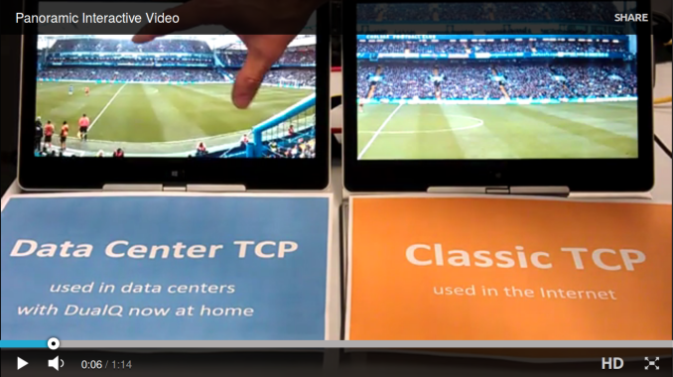
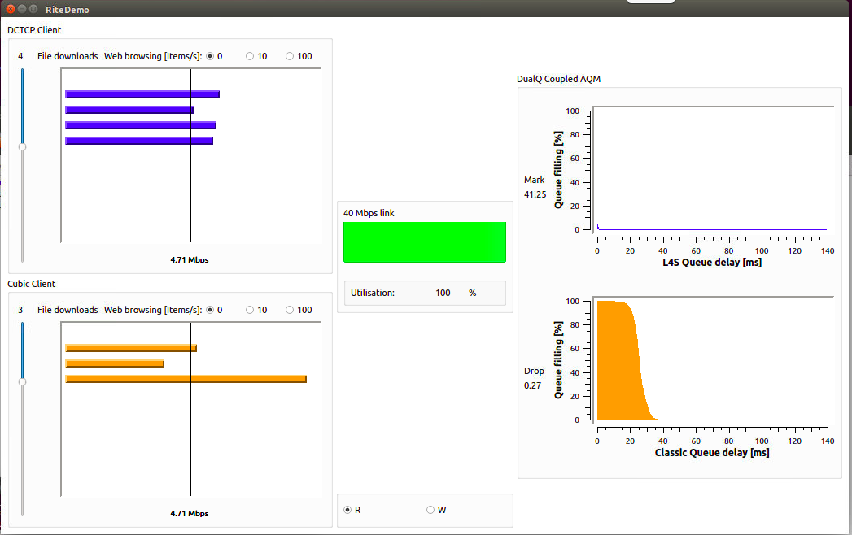
Low Latency Low Loss Scalable throughput (L4S) – background
Latency so low
it sticks to your finger
Recall: demo at Prague IETF (aqm wg & bits-n-bites)
  see https://riteproject.eu/dctth/ for videos, papers, etc
L4S could incrementally replace “best efforts”
    ultra-low queuing delay
    zero congestion loss
    scalable throughput (beyond Reno, Compound, Cubic)
Eventually for all Internet traffic
Aim: to be worth the deployment hassle – so much better than today

Slide 3

very high level
problem: TCP is the elephant in the room
solution: build another room without the elephant
TCP
Scalable
TCP

Slide 4
3 parts to standardise
3
1
2
Scalable
TCP sender
mark
L4S
1
IP-ECN
Classifier
Coupling
priority scheduler
Reno
sender
Classic
mark/drop
1) | The identifier | draft-briscoe-tsvwg-ecn-l4s-id | tsvwg
2) | The DualQ AQM | draft-briscoe-aqm-dualq-coupled | aqm
3a) 3b) | Scalable transport | draft-ietf-tcpm-accurate-ecn draft-ietf-tcpm-dctcp (bis) | tcpm
this talk
#1, #2 are as general as possible
#3a) fixes TCP feedback, other transports are already OK
#3b) one concrete example transport behaviour: DCTCP

Slide 5
choice of identifier
Three possibilities; all involve compromises
    two other possibilities quickly discounted
    ECT(1) + CE chosen
    reasoning recorded in Appendix A of draft
    table highlights solely the distinguishing issues
Legend
 | Poor
 | Ordinary
 | Good
? | Optimistic
Issue | DSCPx + ECN initial eventual |  | ECN* initial | ECT(1) + CE initial eventual
end-to-end? |  | ?
tunnels |  |  | ? | ?
lower layers |  | ? |  |  | ?
codepoints |  | ? |  |  | ?
reordering |  |  |  |  | ?
control packets |  |  |  |  | ?
CAVEAT: The table is not meant to be understandable without referring to the text.
_______________
* only feasible to use ECN alone if Classic ECN becomes obsolete
“ECN” shares the eventual scores of “ECT(1) + CE”

Slide 6

meaning of this new identifier?
Original goals of ECN included lower delay with modified TCP
    but too many combinations to standardise a winner
    so [RFC3168] defined 'Classic' ECN behaviour as equivalent to drop
    ...could allow new criteria to be developed for setting the
    CE codepoint, and new congestion control mechanisms for
    end-node reaction to CE packets. However, this is a research
    issue, and as such is not addressed in this document.
    so ECN inherited the dilemma of drop-based TCP...
Proposed meaning of L4S identifier:
    The likelihood that an AQM drops a Not-ECT Classic packet MUST be roughly proportional to the square of the likelihood that it would have marked it if it had been an L4S packet.
    The constant of proportionality does not have to be standardised for interoperability, but a value of 1 is RECOMMENDED.
queuing delay
under-utilization
packet loss

Slide 7
If we choose ECT(1): what do we preclude?
would obsolete ECN nonce [RFC3540]
    other ways to do feedback integrity without a codepoint
various “less severe than CE” schemes from the research community, incl. for flow start-up
see Appendix B
consider carefully before consuming the last ECN codepoint

Slide 8
Intended Status
If Proposed Standard, it would update:
    ECN in IP [RFC3168]
    ECN in TCP [RFC3168]
    ECN in SCTP [RFC4960]
    ECN in RTP [RFC6679]
    ECN in DCCP [RFC4340]
Draft written as Experimental
    can obsolete ECN nonce (also experimental)
    if experimental, cannot update all the above proposed standards
Discuss

Slide 9
Next Steps
Please review and comment
    brief draft (8pp without boilerplate & appendices)
Plenty of discussion (on aqm) when issue first raised
    quiet since
Industry L4S assessment activities in progress
    TSVWG will need visibility of this before it can adopt

Slide 10
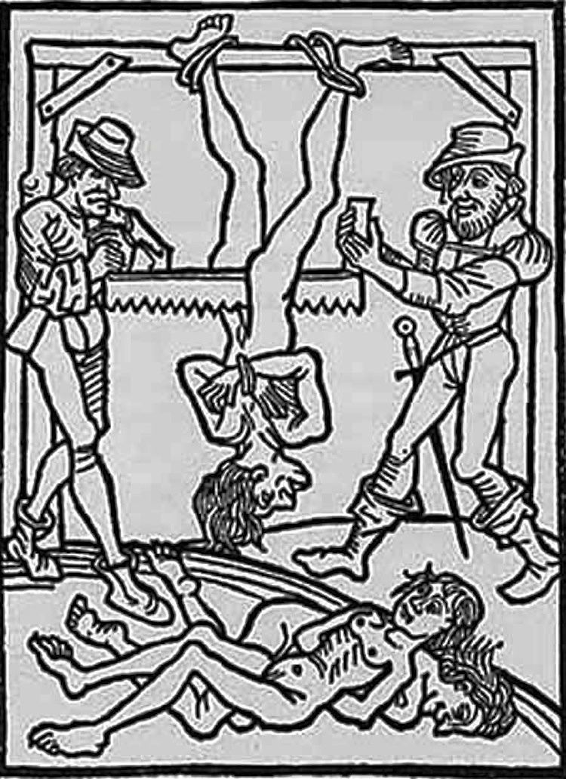
Q&A
large saw teeth can ruin the quality of your experience

Slide 11
Q) why is queuing delay of DCTCP so low?
A1) Finer saw-teeth of a Scalable TCP
Today (at best)
TCP on end-systems
AQM at bottlenecks
DCTCP
change bottlenecks
and TCP
if change bottlenecks
alone
buffer kept for bursts
buffer
occupancy
b u f f e r s i z e
TCP saw-teeth
seeking the
operating point
shallower
operating
point
lower queuing delay and more predictably low
AQM
operating
point
smooth TCP:
more smaller
saw-teeth
line
utilisation
good line utilisation
cuts delay but poorer line utilisation
time
also highly insensitive
to threshold configuration

