Slide 1

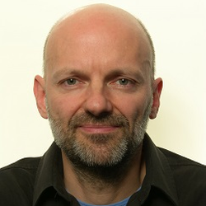


Low Latency Low Loss Scalable Throughput (L4S)
draft-ietf-tsvwg-l4s-arch-04
draft-ietf-tsvwg-ecn-l4s-id-07
draft-ietf-tsvwg-aqm-dualq-coupled-10
Bob Briscoe, CableLabs <ietf@bobbriscoe.net>
Koen De Schepper, N okia Bell Labs <koen.de_schepper@nokia.com>
TSVWG, IETF-105, Jul 2019
Notes:
Cover Slide 1 of 3
Cable Labs

Slide 2
Motivation
Ultra-low queuing delay
for all Internet applications
including capacity-seeking (TCP-like)

Slide 3
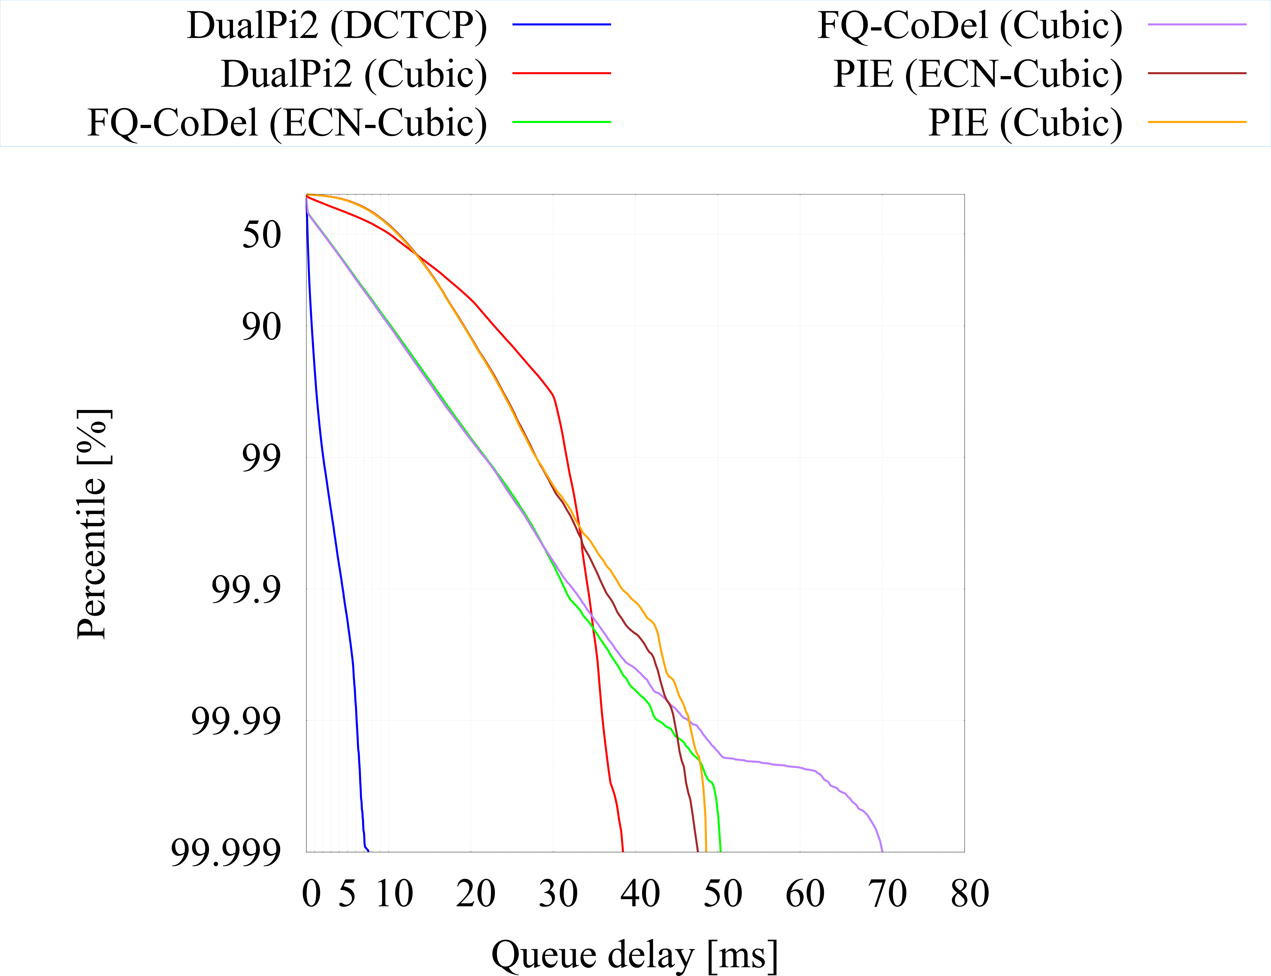
TCP
Performance
DCTCP is the key to consistent low delay
Low delay important at higher %-iles
    for low latency real-time delivery
median Q delay: 100-200μs
99%ile Q delay: 1-2ms
~10x lower delay than best 2nd gen. AQM
    at all percentiles
...when hammering each AQM
    fixed Ethernet
    long-running TCPs: 1 ECN 1 non-ECN
    web-like flows @ 300/s ECN, 300/s non-ECN
    exponential arrival process
    file sizes Pareto distr. α=0.9 1KB min 1MB max
    120Mb/s 10ms base RTT
each pair of plots for one AQM is one experiment run

Slide 4
The trick: scalable congestion control
 | (1) Today (typical) | (2) Today (at best) | (3) Unacceptable | (4) L4S
Bottleneck | Bloated drop-tail buffer | AQM | Shallower AQM | Immediate AQM
Sender CC | Classic | Classic | Classic | Scalable (tiny saw-teeth)
less buffer; still enough for bursts
buffer
occupancy
TCP
saw-teeth
seeking
capacity
even less buffer
consistently low queuing delay
shallower
target
AQM
target
link
utilization
full utilization; insensitive to target
no delay
but poor utilization
time

Slide 5
Coexistence #1
Problem
    Scalable congestion controls more aggressive than 'Classic' (TCP-Friendly)
Solution without flow inspection: Dual Queue Coupled AQM
    Counter-balance with more aggressive ECN-marking
Host
Protocol [L4S-ECN]
1
Network: DualQ Coupled AQM
3
2
L4S marker
Scalable
sender
L4S: [X1]
p
w
ECN
Classifier
conditional priority scheduler
Coupling
p²
Classic
sender
Classic: [X0]
Classic drop or marking
r: packet rate
p: drop/mark probability

Slide 6
Coexistence #2
Solution with flow inspection: FQ_xxx_L4S: simple patch
    If ECT(1), shallow threshold (or ramp) marking
      based on immediate queue – stateless (no smoothing)
      else mark/drop with xxx (CoDel, PIE, etc...)
Description added to draft-ietf-tsvwg-l4s-arch

Slide 7
Implementation status
L4S transport protocols
TCP Prague – Linux Ref
rmcat over RTP: L4S-SCReAM
QUIC Prague
BBRv2
L4S Transport Components
Linux: ECT(1), ECN++
Linux & FreeBSD: AccECN
Ongoing: Paced Chirping, Sub-Pkt-Wnd
DualQ Coupled AQMs
Linux Ref Impl'n:
    DualPI2 resubmitting to mainline
Low Latency DOCSIS:
    ns3 Coupled DualQ AQM
    2 Cable Modem chipset implementations
    multiple CMTS implementations
An Ethernet switch chipset:
    Curvy RED
L4S FQ_CoDel
Linux patch

Slide 8
Open Source links
Dual Queue Coupled AQM
  Linux: https://github.com/L4STeam/sch_dualpi2_upstream
L4S Demo/Test GUI
  Linux: https://github.com/L4STeam/l4sdemo
TCP Prague (ECT(1), ECN++, AccECN)
  https://github.com/L4STeam/tcp-prague (Linux)
QUIC Prague
  https://github.com/qdeconinck/picoquic/tree/quic-prague (Linux, FreeBSD, Windows)
SCReAM with L4S support
  https://github.com/EricssonResearch/scream (Linux, FreeBSD, Windows)
BBRv2 with L4S support
  https://github.com/google/bbr/blob/v2alpha/README.md (Linux)
Paced Chirping (proof-of-concept Linux research code)
  https://github.com/JoakimMisund/PacedChirping

Slide 9
Hackathon
L4S Interop testbed (Olivier Tilmans, Koen De Schepper)
L4S Flent regression tests (Pete Heist, Jonathan Morton, Rodney Grimes)
    Integration with L4S testbed, validated L4S GUI results
FreeBSD AccECN implementation (Richard Scheffenegger, Michael Tuexen)
FreeBSD/Linux AccECN interop (Richard Scheffenegger, Olivier Tilmans)
    first AccurateECN interop connection on the Internet (IETF network)
TCP-Prague sub-packet-window (Asad Ahmed)
TCP-Prague Paced Chirping in ns3 (Tom Henderson, Joakim Misund)

Slide 10
TCP Prague: status against Prague L4S requirements
Linux code: | none | none (simulated) | research private | research opened | RFC | mainline
Requirements |  | base TCP | DCTCP | TCP Prague
 | L4S-ECN Packet Identification: ECT(1) |  | module option | mandatory
 | Accurate ECN TCP feedback | sysctl option | ? | mandatory
 | Reno-friendly on loss |  | inherent | inherent
 | Reno-friendly if classic ECN bottleneck |  |  | open issue
 | Reduce RTT dependence |  |  | simulated
 | Scale down to fractional window | thesis write-up | thesis write-up | thesis write-up
 | Detecting loss in units of time | default RACK | default RACK | mandatory?
Optimizations
 | ECN-capable TCP control packets | module option off | on | default off→on later
 | Faster flow start | in progress
 | Faster than additive increase |  | in progress

Slide 11
Recent developments #1
DualPI2 parameter auto-calc
for Internet: Zero config – just use defaults
for uncommon deployments (eg. DC)
    front-end to auto-calculate 4 parameters
meaningful input parameters | raw input parameters
 | target: queue delay
RTT_typ: typical RTT | Tupdate: sampling interval
RTT_max: maximum RTT | alpha: PI integral gain
 | beta: PI proportional gain

Slide 12
Recent developments #2
Queue Protection function draft-briscoe-docsis-q-protection-00
Informational write-up of DOCSIS algo for the IETF community:
    pseudocode already published in DOCSIS spec.
    this adds context & explanation, and
    objective definition of flow behaviour necessary to avoid packet rejection
Not one of the core L4S drafts – not even a tsvwg draft
    overload protection [aqm-dualq-coupled Appx A.2] likely a sufficient alternative
    during the L4S experiment we'll see if it'is necessary (can be disabled in DOCSIS)
V simple per-flow algo at enqueue to the DOCSIS Low Latency (L4S) queue
    in normal circumstances, does nothing except monitor
    maintains per-flow* queuing scores that allocate responsibility for excess queuing
    the more a configured Q delay threshold is exceeded,
    the more packets from high-scoring flows will be rejected
* flow state expires between a flow's packets, except for ill-behaved flows

Slide 13
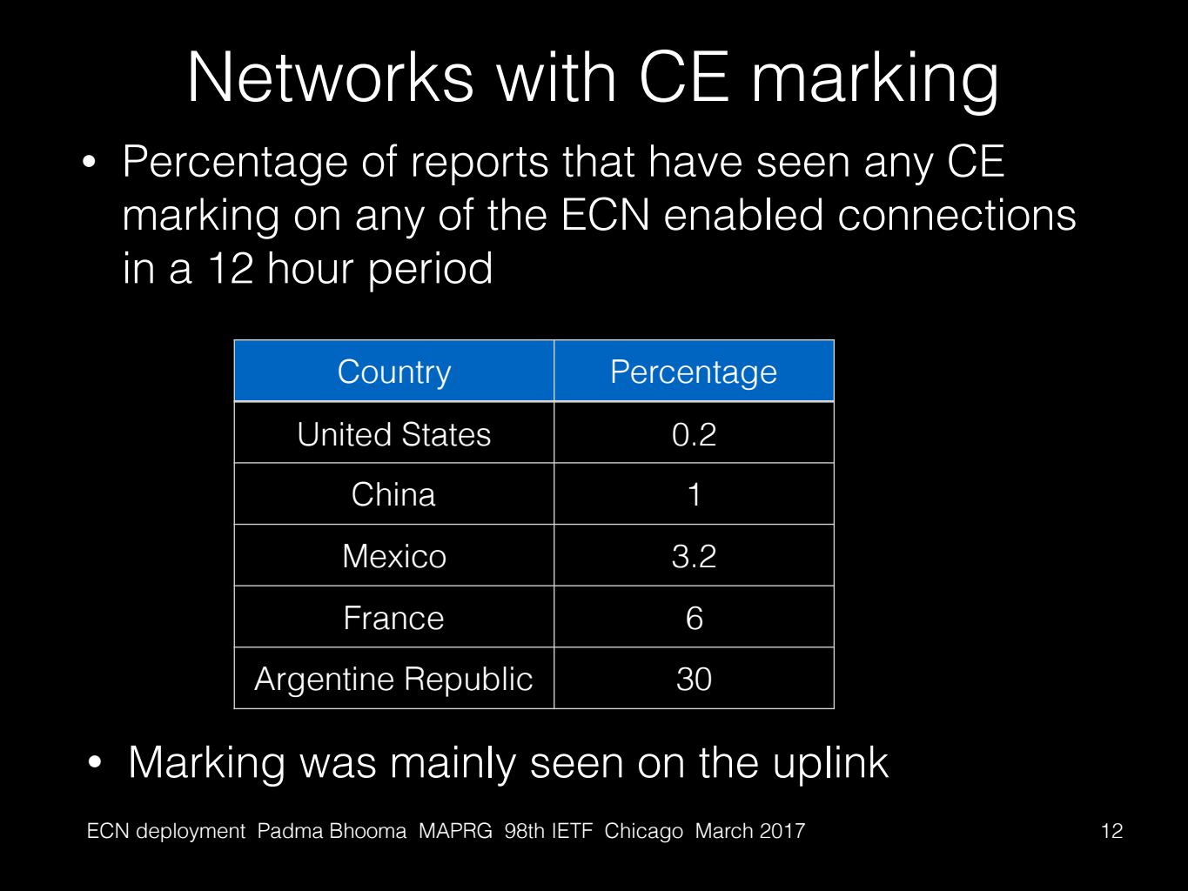
Open issues #1:
RFC3168 ECN in a FIFO
Codepoint | IP-ECN bits | Meaning
Not-ECT | 00 | Not ECN-Capable Transport
ECT(0) | 10 | Classic ECN-Capable Transport
ECT(1) | 01 | L4S ECN-Capable Transport
CE | 11 | Congestion Experienced
Nov 2016, after 16 months of deliberation
    WG chose ECT(1) for L4S ECN
    CE ambiguous, but least worst compromise
    L4S ECN coexists with 3168 ECN, if it's all FQ
All academic ECN studies over the years (incl. 2017, 2019) found virtually no CE marking
    using active measurement
Mar 2017 study by Apple found CE marking
    using passive measurement

Slide 14
Open issues #1:
RFC3168 ECN in a FIFO
Assumed all RFC3168 ECN AQMs likely to be FQ_CoDel
    So L4S traffic would coexist with TCP-Friendly
What to do if assumption is unsound?
Quantify flow imbalance
Testbed measurements (next slide)
Ground truth
Any FIFO RFC3168 ECN routers enabled?
  Two CDNs testing for Echo CE
  Access to results not assured
Devised targeted FQ v FIFO test
Risk
?
Lo-risk, add advice to L4S expt:
Limit experiment over your networks (e.g. disable on CDN ports) if RFC3168 AQM is or will be deployed
Hi-risk: Run-Time Detection?
L4S sender Measures RTT variance
(To be implemented/tested)
. . .

Slide 15
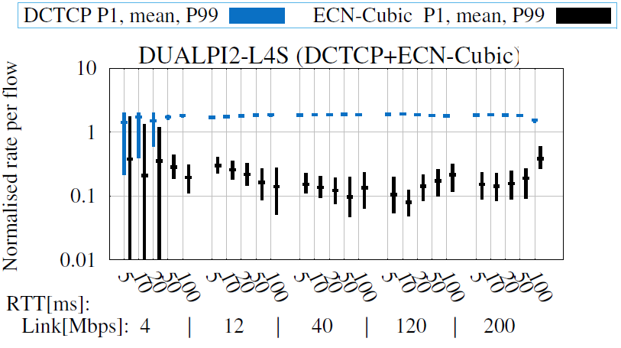
Open issues #1:
RFC3168 ECN in a FIFO

Slide 16
Open issues #2
Loss detection in time units
Objections and proposed fixes:
  'MUST' could be interpreted as a prohibition of 3DupACK in controlled environments where reordering is vanishingly small anyway
        new wording proposed
  Overloads one codepoint with two architecturally distinct functions:
  low queuing delay & low resequencing delay
        Consider value vs cost of 2 independent identifiers
  One experiment (L4S) depending on another (RACK)
        Underlying concern: to avoid L4S success depending on a failed experiment
        If RACK fails (it's already widely deployed), this aspect of L4S can be relaxed
        Note: dependency on the idea under RACK, not a normative reference

Slide 17
Open issues #2
Loss detection in time units
Ways forward (for WG to decide):
    Write as a MUST or a SHOULD?
    Warn that service could degrade if ignore SHOULD

Slide 18
L4S status update: IETF specs
Deltas since last IETF in Red
tsvwg
L4S Internet Service: Architecture <draft-ietf-tsvwg-l4s-arch-04> [UPDATE]
Identifying Modified ECN Semantics for Ultra-Low Queuing Delay (L4S) <draft-ietf-tsvwg-ecn-l4s-id-07> [UPDATE]
DualQ Coupled AQMs for L4S: : <draft-ietf-tsvwg-aqm-dualq-coupled-10> [UPDATE]
Interactions of L4S with Diffserv <draft-briscoe-tsvwg-l4s-diffserv-02>
Identifying and Handling Non-Queue-Building Flows in a bottleneck link draft-white-tsvwg-nqb-02 [UPDATE]
Low Latency DOCSIS - Technology Overview draft-white-tsvwg-lld-00
DOCSIS Low Latency Queue Protection draft-briscoe-docsis-q-protection-00 [NEW]
enabled by <RFC8311> [RFC published]
tcpm
scalable TCP algorithms, e.g. Data Centre TCP (DCTCP) <RFC8257>, TCP Prague
Accurate ECN: <draft-ietf-tcpm-accurate-ecn-09> [UPDATE]
ECN++ Adding ECN to TCP control packets: <draft-ietf-tcpm-generalized-ecn-04> [UPDATE]
Other
ECN support in trill <draft-ietf-trill-ecn-support-07>, motivated by L4S [RFC Ed Q]
ECN in QUIC <draft-ietf-quic-transport-22>, [motivated by L4S – Multiple Updates, but not ECN part]
ECN & Congestion F/b Using the Network Service Header (NSH) <draft-ietf-sfc-nsh-ecn-support-01> [ADOPTED] [supports L4S-ECN]

Slide 19

Next Steps for 3 core L4S drafts
Classic ECN bottleneck work
WG Last Call (?)
Address issues raised
L4S experiment can start

Slide 20
Low Latency Low Loss Scalable Throughput (L4S)
Q&A
Notes:
Cover Slide 1 of 3
Cable Labs

Slide 21
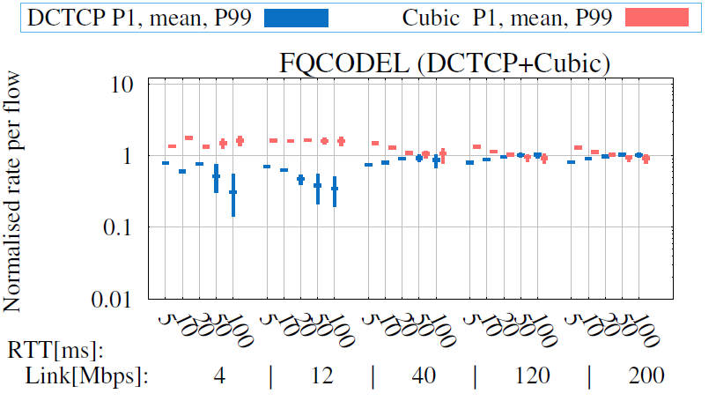
Open issues #1:
RFC3168 ECN in a FIFO

Slide 22
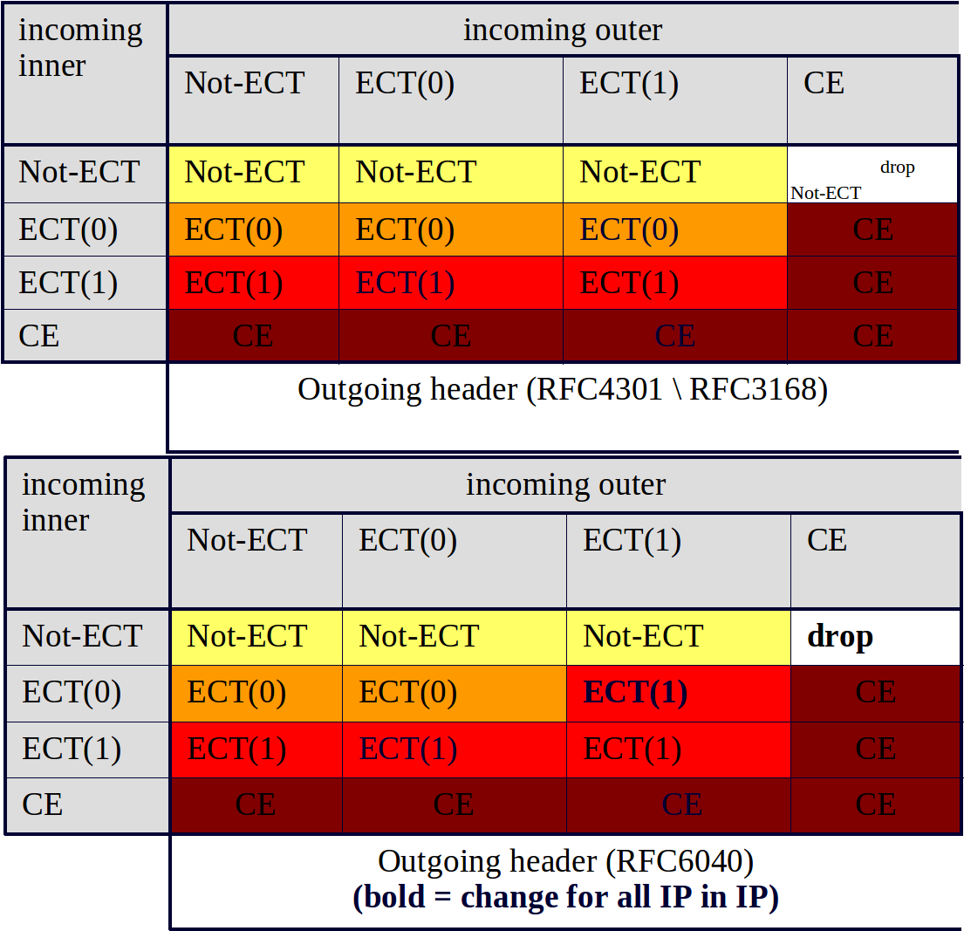
ECN transitions
RFC3168 & RFC8311
    ECT(0) → CE
    ECT(1) → CE
RFC6040 added support for RFC6660
    ECT(0) → ECT(1)
Many encapsulations will still be pre-RFC6040
    decap will revert ECT(1)
Ambiguity of CE
    ECT(0) → CE early on path
    CE → L4S queue later on path
    5 unlikely scenarios have to coincide
    to cause an occasional spurious re-xmt

